Slide 1
Unit 3-3
Parallel Lines and the Triangle Angle Sum Theorem
PLANE Geometry

Slide 2



Triangle Angle-Sum Theorem:
The Sum of the Measures of the Angles of a Triangle is 180.
$$B$$
$$m∠A+m∠B+m∠C=180°$$
$$A$$
$$C$$

Slide 3


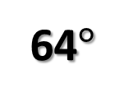




Example 1:
Find $m∠1.$
$$48°$$
$$1$$
$$1$$
$$73°$$
$$58°$$
64$°$

Slide 4




Example 2:
Find $x.$
$$3x+20$$
$$3x+18$$
$$4x+12$$

Slide 5

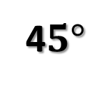



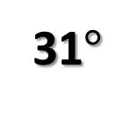

Example 3:
Find $x, y, and z.$
$$54°$$
31$°$
4$5°$
$$x$$
$$y$$
$$z$$

Slide 6



Example 4:
Find $a.$
$$48°$$
$$a$$

Slide 7
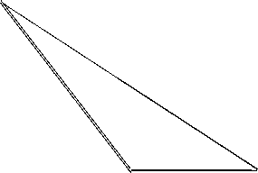
Classify Triangles by Angles
Equiangular
All Angles are Congruent
Acute
All Angles are Acute
Right
One Right Angle
Obtuse
One Obtuse Angle

Slide 8
Classify Triangles by Sides
Equilateral
All Sides are Congruent
Isosceles
Two Sides are Congruent
Scalene
No Sides are Congruent

Slide 9




Triangle Exterior Angle Theorem:
The Measure of Each Exterior Angle of a Triangle Equals the Sum of the Measures of Its Two Remote Interior Angles.
$$m∠1=m∠2+m∠3$$
$$2$$
Exterior Angle
Remote Interior Angles
$$1$$
$$3$$

Slide 10
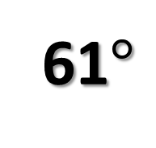
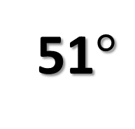
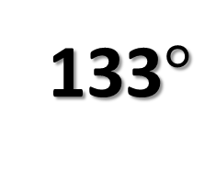



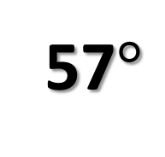
Example 5:
Find the Missing Angle$.$
57$°$
61$°$
$$x$$
51$°$
133$°$
$$x$$

Slide 11



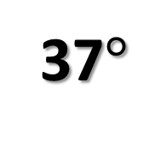
Example 6:
Find x$.$
37$°$
$$5x+62$$
$$3x+47$$

